Slide 1
POHMS
Creating a Healthy Work Environment
Kathleen Bartholomew, BS, RN, MN
kathleenbart@msn.com
April 28, 2023
Notes:
Riddle: What is the question we answer every day?

Slide 2
Notes:
We think we present what we want to present
We present again and again what we are really feeling or thinking. People know it.
How to spot a liar e.g. Clinton
I did not
That woman
Feet towards the door
Put object between them and interviewer
Real smile is in the eye muscles which cannot consciously contract

Slide 3
“Alas, culture is not what we say, what we think, what we mean, or even what we intend; it's what we do.” Jon Burroughs, MD
Notes:
It is well known that culture dictates behaviors
So if you want to know what your culture is like -- list the behaviors
Working with difficult co-workers – standards
\Cognitive Dissonance

Slide 4
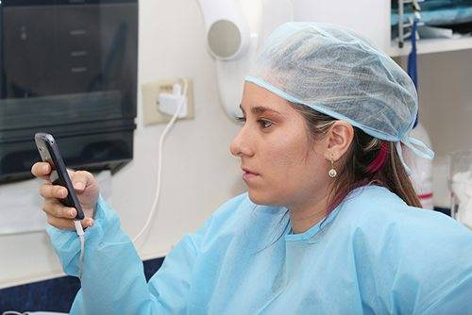
Notes:
Caminiti C, Deng L, Greenberg P, Scolpino A, Chen C, Yang E, Oleske JM. The Impact and Perception of Cell Phone Usage in a Teaching Hospital Setting. J Patient Exp. 2020 Dec;7(6):1627-1633. doi: 10.1177/2374373519892416. Epub 2020 Jul 17. PMID: 33457623; PMCID: PMC7786706.
Who determines what is normal?
System?
Nebraska – cell phone use and ICU
California – cell phone use and death
We check our cell phones once every 12 minutes, millennials 80 times and now the “I generation” is up to 150 x day

Slide 5
Major Factors Effecting Communication
Hubris
Work complexity
Time compression
Multi-tasking
Human adaptability - habit
Culture
Hierarchy

Slide 6
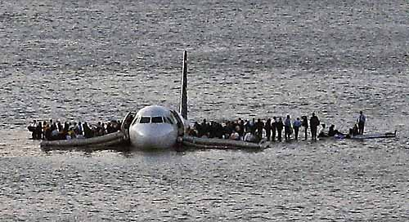

Slide 7
“Work Complexity”
Multiple goals, unpredictability and constant change
Disjointed work supply sources
Missing equipment/supplies
Repetitive travel
Multiple interruptions
Waiting – for system or processes
Difficulty in accessing resources
Inconsistent communication
Breakdown in communication (Ebright)
Notes:
This is the standard list of HF’s that HRO’s and airlines have tried to control to achieve high safety levels. Ask if there are any rules or attitudes in medicine to deal with these issues. Except for the recent limitations on Resident hours – there are none. The impact of limiting resident hours is to INCREASE staff on call time in most instances.

Slide 8
Practice Findings
Interrupted mid-task 8 times
Experience 8.4 work failures per shift
Tasks take an average of 3 minutes each
Over 160 tasks in an 8 hour shift
7-8 items staked at any given time 10 or more waiting to be performed
Lack of time for reflection, delegation and assessment (Tucker, 2006)
Notes:
Tucker AL, Spear SJ. Operational failures and interruptions in hospital nursing. Health Serv Res. 2006 Jun;41(3 Pt 1):643-62. doi: 10.1111/j.1475-6773.2006.00502.x. PMID: 16704505; PMCID: PMC1713207.

Slide 9
A decade later…
More tasks performed 7 – 11 am
Average of 124 communications and
208 tasks in any 4 hour block of time
Multitasking - communications and tasks
131 times or 40% of the time
Yen et al. 2017
Notes:
Of note – 10% of tasks were delegable
Of note – we went from 160 tasks in an 8 hour shift to 416 in a decade
A fundamental understanding of multitasking within nursing workflow is important in today's dynamic and complex healthcare environment. We conducted a time motion study to understand nursing workflow, specifically multitasking and task switching activities. We used TimeCaT, a comprehensive electronic time capture tool, to capture observational data. We established inter-observer reliability prior to data collection. We completed 56 hours of observation of 10 registered nurses. We found, on average, nurses had 124 communications and 208 hands-on tasks per 4-hour block of time. They multitasked (having communication and hands-on tasks simultaneously) 131 times, representing 39.48% of all times; the total multitasking duration ranges from 14.6 minutes to 109 minutes, 44.98 minutes (18.63%) on average. We also reviewed workflow visualization to uncover the multitasking events. Our study design and methods provide a practical and reliable approach to conducting and analyzing time motion studies from both quantitative and qualitative perspectives.

Slide 10
Dominant Group
Oppressed Group

Slide 12
32.8% linked DB with adverse events
35.4% linked to medical error
24.7 % to compromising patient safety
12.3% to mortality (Rosenstein, 2011)

Slide 13
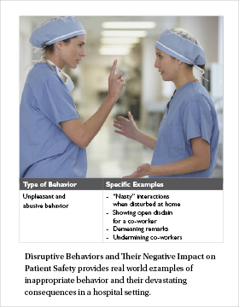
Incivility
Notes:
Scenario #2
Role play problem in OR ……then
Doctor complains to chief of surgery
Nurse manager complains to Chief Nurse
I’ll never scrub with that idiot again. I’m not the only one. Half the nurses wont…..
Other nurses defend doctor – stress – familiy problems – then the census will drop and will have lay offs. Just calm down.

Slide 14
Overt:
name-calling, sarcasm, bickering, fault-finding, back-stabbing, criticism, intimidation, gossip, shouting, blaming, put-downs, raising eyebrows, etc.
Covert:
unfair assignments, eye-rolling, ignoring, making faces (behind someone’s back), refusal to help, sighing, whining, sarcasm, refusal to work with someone, sabotage, isolation, exclusion, fabrication, etc.
Notes:
“Mister, everybody knows you don’t need a lid on a bucket of crabs.

Slide 15
How frequently do you see these overt and covert behaviors?
1. Not at all
2. Once or twice a week
3. More than 3 times a week
4. Several times every day

Slide 16
Aftermath…
“Nearly everyone got even”
Intentionally lower productivity -66%
Cut back hours – 80% lost work time
Give minimal effort
Quit – months afterward 12%
Lost respect for boss
(The Cost of Bad Behavior)

Slide 18
HIERARCHY
Staff complain to mgr. or each other
Boss solves problems
People know their place
No feedback sought
Secrecy and blame
Control as key
Different rules for different roles

Slide 19
HIERARCHY
Staff complain to mgr or each other
Boss solves problems
People know their place
No feedback sought
Secrecy and blame
Control as key
Different rules for different roles
TRIBE
Staff take accountability
Staff seek resolution
People know their value
Peer evaluations
Just Culture – open sharing
Relationships as key
100% of staff held to same standard

Slide 20
“Our lives begin to end
the day we become silent about things that matter”
M. L. King
Notes:
There comes a time when silence is betrayal

Slide 21
Notes:
Intentionally left BLANK

Slide 22
Why don’t you speak your truth?
Fear of retaliation
Fear of hurting the relationship/feelings
Fear of gossip, scapegoating,
No time
Why bother? Nothing will change
Fear of being isolated from the group
(Bartholomew, 09)
Notes:
CRITICAL: Talk about Dr. Gallagher’s study at UW with cancer patients

Slide 24
OBJECTIVE
CURE
SCIENCE
LEFT BRAIN
SUBJECTIVE
CARE
ART
RIGHT BRAIN

Slide 25
What is the most important predictor
of any team’s success?

Slide 26
Personality Individual intelligence Skill level
Communication patterns Substance or Content Something else?

Slide 27
Patterns of communication A. Edmondson, HBR

Slide 28
Observed Norms
Fear based
Culture of self silencing
Skill deficit - communication
Hierarchical
Competing values
Cognitive dissonance

Slide 29
New Norms
Fear based – Break from the pack
Culture of silencing – Take risks
Skill deficit – Hard conversations
Hierarchical - Everyone matters
Competing values – The patient #1
Cognitive dissonance - “IF”

Slide 30
Major Factors Effecting Communication
Hubris
Work complexity
Time compression
Multi-tasking
Human adaptability - habit
Culture
Hierarchy

Slide 31
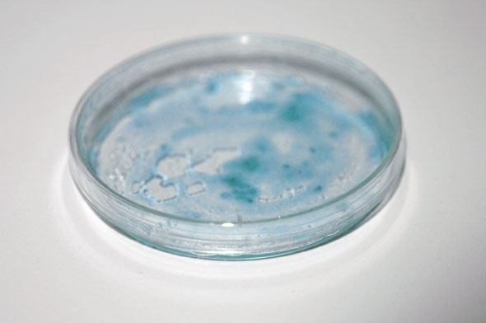
To thrive a toxic culture requires: secrecy shame silent witness *

Slide 32
Define Professional Relationships
Consistent professional demeanor
Maintains a positive attitude and fosters solutions
Asks, gives and receives feedback in a way that improves performance
Demonstrates respectful listening
Genuinely cares for others
Observes and reflects on his or her own behavior

Slide 33
Am I Dauntless?
I don’t talk about someone who isn’t present.
I routinely ask my peers for feedback.
I don’t email or text when I am upset with co-workers
I help others when I am caught up with my work.
I would let anyone on my unit care for my loved one
I don’t join into the blame game when something goes wrong.
I don’t tear someone down to lift myself up.
I invite new people to join me for a meal or coffee.
I don’t sigh, roll my eyes or raise my eye-brows. I use words.

Slide 34
Difficult Coworkers

Slide 35
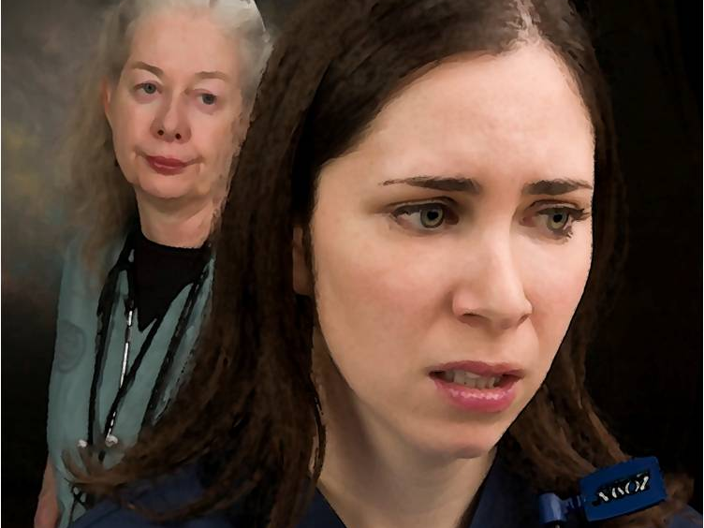

Slide 36
“When someone dumps their toxic feelings on us…they activate in us circuitry for those very same distressing emotions.
Their act has powerful neurological consequences: emotions are contagious.”
Daniel Goleman

Slide 37
What do you say after you hear that
someone has been backstabbing you?

Slide 38
DESC Communication Model
Describe - Lead with the facts
Explain – Let them know the impact
(pause, pause, pause)
State – What you want. Be descriptive
Consequences – Describe the impact
(individual, social and work env.)

Slide 39
What do I do when I walk into the manager’s office, and I can tell by her tone and expression that she has made up her mind already?
D
E
S
C

Slide 40
D – As soon as I walked into your office I noticed that your jaw is set and your face looks stern
E - I am defensive, anxious and afraid that the open dialogue that I wanted to have with you just isn’t going to happen
S - What I need is for you to listen to me before you make up your mind because I need your support and understanding. Ask me questions instead of jumping to any conclusions
C - So that I can tell you what I know and together we can solve this issue

Slide 41
DESC Communication Model
D - When…
E - I feel…because
S - Therefore, I want (I need)
C - So that…

Slide 43
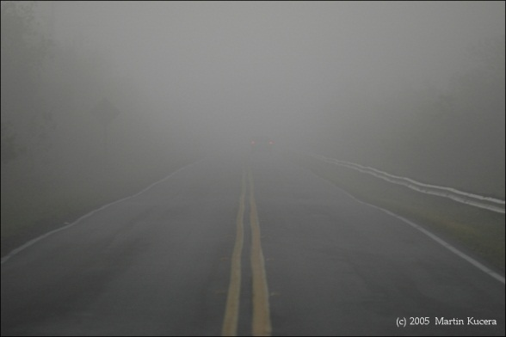
The Grey Zone
Notes:
Is it okay to text at a meeting?
Can night shift spend a few hours on Facebook if its quiet?

Slide 44
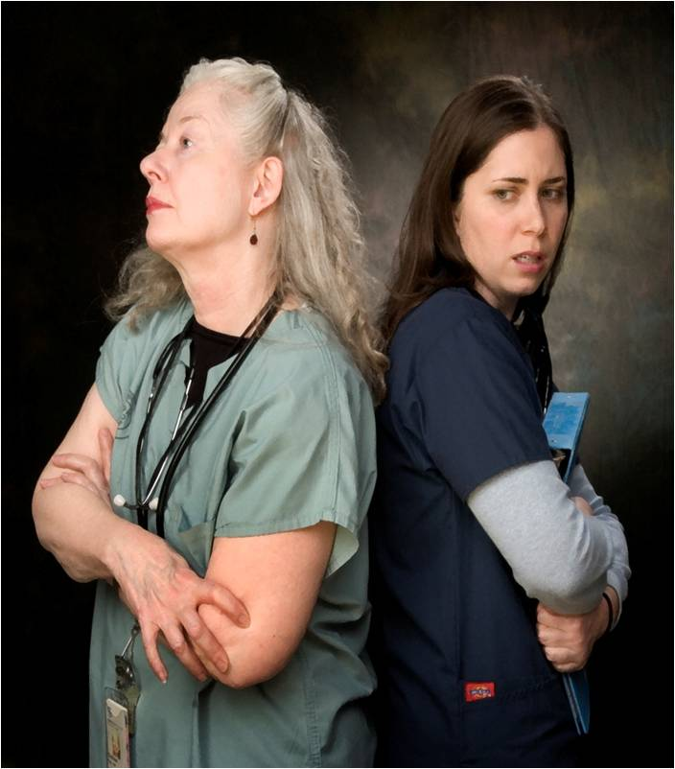
Responding
to to
Hostility
Non-verbal inuendos (e.g. making faces)
“I see from your facial expression that there may be something you wanted to say to me. It’s ok to speak to me directly”

Slide 45
Sabotage (setting up a negative situation)
“There is more to this situation than meets the eye. Could you and I (or whoever) meet in private and explore what happened?”
Verbal affront (covert or overt snide remarks, lack of openness or abrupt responses)
“Can I talk to you in private? When you____ I got the feeling that you______. Is that the case?”

Slide 46
Infighting (bickering with peers)
“This is not the time or place. Please stop” Then physically walk away or move to a neutral spot
Backstabbing (complaining to others about an individual)
“I don’t feel right talking about him/her/the situation when I wasn’t there. Have you spoken to him/her? “
M. Griffin

Slide 47
Notes:
Experiences mental and physical stress
Demonstrates compassion, altruism, hunts and shares
Uses non verbal gestures in context
Shows emotions of happy , sad, grief, fear, despair and humor
Recognizes self

Slide 48
Notes:
Humans in Groups
Group Think
Bystander Effect
Lack objectivity
Assimilation – can, must, never
Belonging at all cost
Creatures of habit – status quo
Risk adverse

Slide 49
What can you do?
Ask for Feedback - today
What do I do well?
What would you like to see more of?
2. Always speak your truth
Self silencing = powerlessness
3. Call it what it is…”I noticed that…”
Make the non-verbal, verbal
4. NEVER be a “silent witness”
“Nothing About Me Without Me”
Notes:
RECRUIT
When you interview candidate the best tool you have is your relationship with your staff
Elevator
RETENTION
plateau
quality of relationships and the work enviornment
Doctors lounge, coffee
Sheer number of hours that we spend here

Slide 50
Leaders: Create a Culture of Trust
Flatten the hierarchy
Focus on Language and Behavior
Everyone actively seeks feedback
Zero Tolerance Policy and
100% compliance
Notes:
We threw the seeds of Just Culture onto cement
The soil they needed to grow in was trust
It’s the little things
Smiling, thank you, attentive listening, humbling asking questions
What do people want most from their leaders?
Respect
Then leaders are seen as warm and competent
56% Healthier
92% More focused
55% More engaged
1.1 x Greater retention
Mother/Father
Campbells soup company Doug Conant – high performance standards AND civility
Study of leadership during the pandemic – authoritarian statement AND empathy

Slide 51
Notes:
Who do you want to be?
Asks Christine Porath
We answer this question every day.

Slide 52
…to communicate honestly with each other, to have relationships that go deeper than the mask of composure, to develop some significant commitment to share life’s deeper experiences. Scott Peck

Slide 53
Resources
Educational Series – Three 10 minute videos
http://www.kathleenbartholomew.com/resources/educational-mini-series.htm
TedX
Christine Porath https://www.ted.com/talks/christine_porath_why_being_respectful_to_your_coworkers_is_good_for_business?user_email_address=b93e2cbbd62005215c07889018f0a011
Kathleen Bartholomew
https://www.youtube.com/watch?v=Qh4HW3yx00w
Books: The Dauntless Nurse: Communication Confidence Builder, Ending RN-RN Hostility; and The Cost of Bad Behavior, Porath/Pearson

Slide 54
Thank you!
Kathleen Bartholomew
kathleenbart@msn.com
206-356-2599
www.kathleenbartholomew.com
Notes:
Process of disregarding or reframing information that doesn’t align with belief or desire.

