Slide 1
A Look into Healthcare Priorities in 2023: Expanding Telehealth Access, Embracing Transparency and Increased OIG Scrutiny
S. Leigh Davitian, JD
Dumbarton Group and Associates, LLC
April 28, 2023

Slide 2
Presentation Outline
Healthcare Showdown: Congress versus Congress
Looks What’s in the Rearview Window: Public Health Emergency
Telehealth Post-COVID: Expanding Access but Exploding Fraud
Transparency in Healthcare: No More Surprises
HHS-OIG on Steroids
Down Memory Lane: Knowing Compliance Basics

Slide 3
Disclaimer: Not Rendering Legal Advice Strictly Non-partisan No commercial endorsements Accepts Interruptions

Slide 4
SPRING in Washington, DC
This Photo by Unknown Author is licensed under CC BY-SA

Slide 5
Election Circus
This Photo by Unknown Author is licensed under CC BY-SA-NC

Slide 6
Media Circus
This Photo by Unknown Author is licensed under CC BY-SA

Slide 7
Controversies Being Covered by Media Circus
25th Amendment of Senators
Forced Exile Sen. Feinstein, Sen. Grassley
Impeachment of President Biden
New Presidential Trend
Lawsuits of Donald Trump
12 and counting
Investigations of Hunter Biden
Where to begin?
Supreme Court Justices Behaving Badly
Attacks on Disney and Mickey Mouse
Pentagon Papers on Gaming Platforms
People Being Shot … Everywhere
Media Personalities Being “Fired” –Daily

Slide 8
Issues of Debate 118th Congress
Debt Ceiling
Taxes
Economy, Jobs
Education
Election Integrity
Big Tech Reform
Data Privacy
Immigration
Foreign Policy
Farm Bill
Infrastructure
Health Care

Slide 9
Current Health Care Issues Being Debated
Women’s Health and Reproductive Rights
Gender Discrimination Protections
Health Care Workforce Issues – Staffing
Behavioral /Mental Health Expansion
Physician Payment Cuts/Beneficiary Coverage

Slide 10
Current Health Care Issues Being Debated
Drug Pricing – Transparency
Surprise Billing - Transparency
Aggressive Audits, Investigations
Telehealth Expansion
Public Health Emergency Phase-out

Slide 11
118th Congress: Long Road to Passage
Introduced
Debated
Passed

Slide 12
Audience “Democratic” Exercise No Surprises Act OR Telehealth Expansion

Slide 13
Transparency in Healthcare

Slide 14
Transparency: Beneficiary and Industry Outcry
Transparency started with the Affordable Care Act
Health Insurance Consumer Understanding
Nursing Home Ownership
Medicare Auditing Practices – Transparent practices for provider community
Drug Pricing Transparency
Manufacturers, PBMs, and health plans must report prices and changes
Pharmacies/Pharmacists must help consumers better understand their options
Healthcare Pricing Transparency
Health Plan Coverage
Hospital Price Transparency
Surprise Billing for Consumers
No Surprises Act passed 2020; Effective January 1, 2022

Slide 15
PATHWAY TO NO SURPRISES: 2010 - 2020
No Surprises Act passed in December 2020
Requirements related to No Surprises Act released Part I in July 2021
Requirements related to No Surprises Act released Part II in July 2021
Act partially went into effect beginning in 2022
Lawsuits by physician and hospitals filed in 2022
Changes to requirements began in December 2022
Enforcement of requirements began on January 1, 2023
More changes to regulatory structure April 2023

Slide 16
The law aims to help consumers understand health care costs “in advance” of care to minimize unforeseen -or- surprise medical bills

Slide 17
What is the Surprise Billing Act in a Nutshell?
New Federal protections against surprises medical bills for consumers
New Federal protections against balance billing for services out-of-network providers

Slide 18
Defining Balance Billing
Balance billing happens when a consumer seeks care with an “in-network” provider or at an “in-network” facility but said consumer receives services/treatments that are “out-of- network” without any prior knowledge or authorization

Slide 19
Common Example of Balance Billing
Provider charges consumer $100
Plan pays for $70
Consumer owes remaining $30

Slide 20
Consumer Driven
PREMISE: Consumers are rarely informed of the costs of medical treatment in advance
When a consumer gets a medical bill, they usually don’t know
If they actually received said services they were billed for
If the correct amount was billed
If the amount was covered by their insurance
If the amount was already paid or,
If the amount was partially paid
If they are going to receive a bill
If they have recourse to dispute bill
If they have questions or concerns

Slide 21
Surprise Billing Act Protects Consumers
Group Health Plan
Individual Health Coverage
Uninsured
Or Self-Pay

Slide 22
Surprise Billing Act Impacts
Physicians
Plans
Facilities

Slide 23
Part I of the NSA does NOT apply to traditional private physician practices https://www.federalregister.gov/documents/2021/07/13/2021-14379/requirements-related-to-surprise-billing-part-i Part II of the NSA DOES apply to traditional private physician practices https://www.federalregister.gov/documents/2021/10/07/2021-21441/requirements-related-to-surprise-billing-part-ii

Slide 24
(10) Primary Highlights for Providers and Facilities
No balance billing for out-of-network emergency services
No balance billing for air ambulance services by nonparticipating providers
Providers and facilities must publicly disclose patient protections against balance billing
Providers must give a good faith estimate (GFE) of expected charges to the uninsured and self-pay patients at least (3) days before a scheduled service or upon request
Establishing a “patient-provider dispute resolution” process for uninsured (or self-paying) individuals to determine payment amounts due to a provider or facility under certain circumstances

Slide 25
(10) Primary Highlights for Providers and Facilities
6. Holds patients liable only for their in-network cost-sharing amount, while giving providers and insurers an opportunity to negotiate reimbursement
7. Allows providers and insurers to access an” independent dispute resolution” (IDR) process in the event disputes arise around reimbursement
8. Plans, issuers, facilities and providers must ensure “continuity of care” when a provider’s network status changes
9. Plans, issuers, facilities, providers must implement certain measures to improve accuracy of provider directory information
10. Providing consumers with information to appeal certain health plan decisions

Slide 26
Roadmap to understanding the ACT is NOT a straight line

Slide 27
“…. implementing the No Surprises Act (and its vast regulatory framework) is daunting at best and is causing confusion to the private practice community. As time passes, it appears there are financial difficulties for some physicians especially if they are a part of a smaller practice – as they do not have the necessary resources to meet the requirements nor fully understand the laws implications
-- Leigh D

Slide 28
This Photo by Unknown Author is licensed under CC BY

Slide 29
Private Practice Physicians: It’s All a Puzzle
No Surprises Act has a lot of provisions and requirements that are NOT applicable to private practice physicians
These non-applicable provisions are changing
Different rules for insured patients and uninsured patients
Good Faith Estimates versus Advanced EOB?
Good Faith Estimates have to be given to uninsured (3) days in advance
Certain providers are allowed to ask patients in advance to waive protections from surprise medical bills by signing a consent waiver under strict limitations that disallow requests at the time of service
Private practice physicians can use resources to assist with the IDR process to ensure they receive fair compensation

Slide 30
https://www.ama-assn.org/system/files/ama-nsa-toolkit.pdf

Slide 31
Policies & Resources Review rules and fact sheets on latest No Surprises rules and impact on all players
https://www.cms.gov/nosurprises

Slide 32
Consumers
Learn about rights and protections for consumers to end surprise bills and remove consumers from payment disagreements between providers, health care facilities and health plans.
https://www.cms.gov/nosurprises

Slide 33
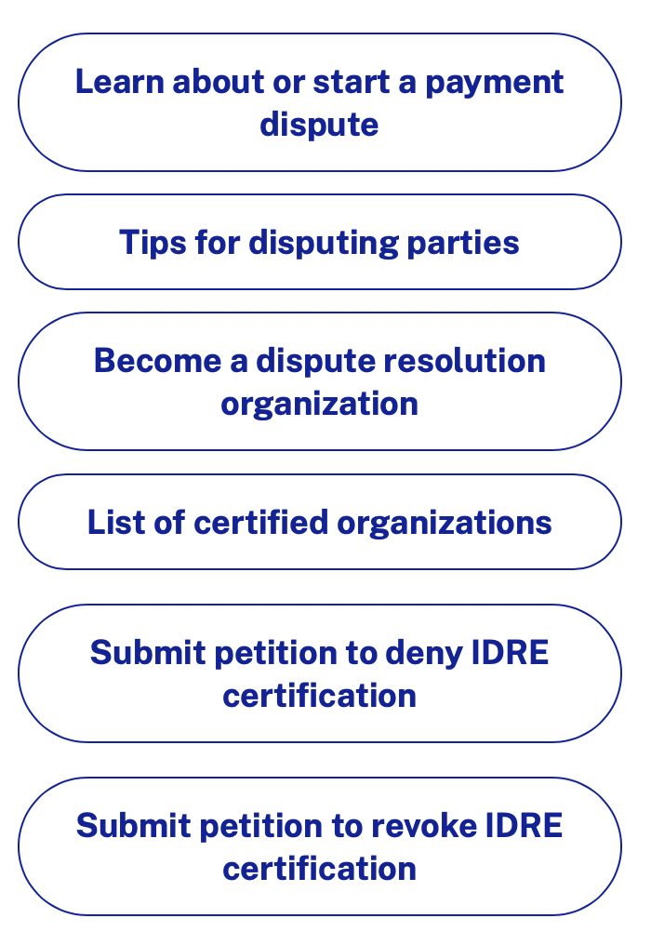
Resolving out-of-network payment disputes
Learn about out-of-network payment disputes between providers and health plans and how to start the independent dispute resolution (IDR) process
https://www.cms.gov/nosurprises

Slide 34
The Endemic: The End of PHE

Slide 35
Evolution of Public Health Emergency
January 31, 2020 - HHS declares public health emergency (PHE)
February 1, 2020 - Receives requests for flexibilities from health care providers/settings
February 27, 2020 - 47 states have known COVID-19 cases
March 1, 2020 – President Trump proclaims that COVID-19 growing outbreak in the US constitutes an immediate “national emergency“
Notes:
Increased budget to hire necessary experts and administrative staff
Increased authority to investigate and reconsider existing providers to remain in the government health care programs
Revalidation
Established ability to implement detailed screening process to allow NEW Medicare providers in governmental programs
Enrollment
Increased authority to identify, investigate, and cease fraudulent and abusive practices by providers
Increased identify, investigate, cease waste and errors of providers
Increased authority to collect overpayments, improper payments

Slide 36
PHE Gives Birth to Blanket Waivers
March 1, 2020 – CMS creates ”blanket waivers” using authority Section 1135 (b) of SSA
CMS processes over 250,000 waiver requests
Flexibilities for Medicare AND Medicaid Telehealth services
Flexibilities for Medicaid Eligibility requirements
Physician and Nurses ability to practice across state lines
HIPAA requirements relaxed
HHS/CMS suspended most Medicare audits activity
Notes:
Increased budget to hire necessary experts and administrative staff
Increased authority to investigate and reconsider existing providers to remain in the government health care programs
Revalidation
Established ability to implement detailed screening process to allow NEW Medicare providers in governmental programs
Enrollment
Increased authority to identify, investigate, and cease fraudulent and abusive practices by providers
Increased identify, investigate, cease waste and errors of providers
Increased authority to collect overpayments, improper payments

Slide 37
COVID-19 Flexibilities and Waivers for Physicians and Clinicians
https://www.cms.gov/files/document/physicians-and-other-clinicians-cms-flexibilities-fight-covid-19.pdf

Slide 38
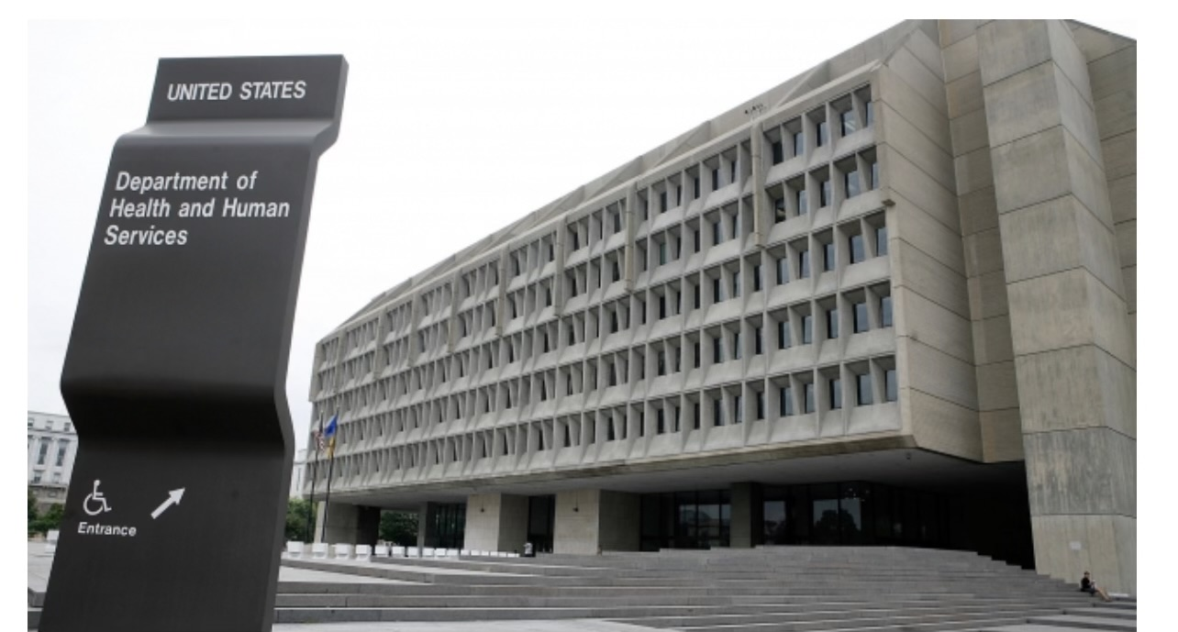
Extension of the Public Health Emergency
January 31, 2020
April 20, 2020
July 23, 2020
October 2, 2020
January 7, 2021
April 15, 2021
July 19, 2021
October 15, 2021
January 14, 2022
April 12, 2022
July 15, 2022
October 13, 2022
January 30, 2022 90-day notice given
Notes:
Increased budget to hire necessary experts and administrative staff
Increased authority to investigate and reconsider existing providers to remain in the government health care programs
Revalidation
Established ability to implement detailed screening process to allow NEW Medicare providers in governmental programs
Enrollment
Increased authority to identify, investigate, and cease fraudulent and abusive practices by providers
Increased identify, investigate, cease waste and errors of providers
Increased authority to collect overpayments, improper payments

Slide 39
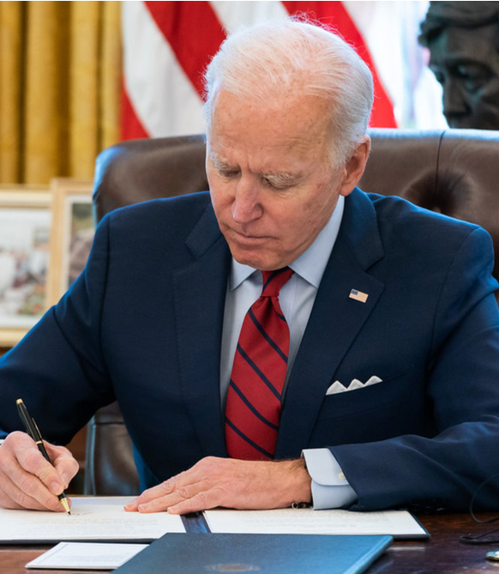
President Biden signs the Consolidated Appropriations Act into law allowing for $1.7 trillion to extend select flexibilities until 2024
Signed – December 29, 2023

Slide 40
President Biden signs a bill to end COVID-19 “National Emergency” beginning on May 11, 2023
Signed - January 20, 2023
This Photo by Unknown Author is licensed under CC BY-SA-NC

Slide 41
Roadmap to Post-PHE is NOT a straight line

Slide 42
https://www.hhs.gov/about/news/2023/02/09/fact-sheet-covid-19-public-health-emergency-transition-roadmap.html

Slide 43
QUICK OVERVIEW: Post Pandemic
HHS planning for the federal COVID-19 public health emergency ends on
May 11, 2023
HHS created a fact sheet to explain what will be affected
Who
How
When
Many waivers, flexibilities for health care providers WILL end
Roadmap in constant flux. Check CMS.GOV often
Coverage, reimbursement, regulations changes to PRE-COVID-19 times

Slide 44
Roadmap Assists Provider Community
Identifies what WILL be immediately affected
Identifies what WILL NOT be immediately affected
Identifies what TEMPORARY changes will be in place
Identifies how providers can navigate changes in reimbursement
Identifies how providers (and beneficiaries) can understand changes in coverage
Identifies possible confusion between state and federal changes

Slide 45
Telehealth Policies Post PHE: IMMEDIATELY Phased Out
Select clinicians practicing across state lines – non-licensure
Reimbursement for many occupational and physical therapy services, emergency department visits
Reimbursement of some group psychotherapy
Prescribing controlled substances without an in-person examination
Requires providers to adhere to strict rules
Patient to be located in a doctor’s office or hospital registered with the DEA to be prescribed a controlled substance

Slide 46
Telehealth Policies Post-PHE: Temporary Policies in Place
Medicare coverage of audio-only telehealth
Medicare reimbursement for telehealth services provided to patients at home
Medicare reimbursement for an expanded list of eligible providers, such as occupational therapists, physical therapists, speech language pathologists, audiologists, and pharmacists
Rural health centers will continue to be reimbursed for ‘interactive, real-time telecommunications technology’ for a mental health disorder

Slide 47
Telehealth Polices Post-PHE: Remains Permanently
Medicare reimbursement for eligible telehealth services when the patient is located in a geographically rural area
Medicare reimbursement for mental health telehealth services provided that there is an in-person visit within the first six months of an initial telehealth visit
Medicare reimbursement to federally qualified health centers and rural health clinics
CMS has redefined a ‘mental health visit’ to now include encounters furnished through interactive, real-time telecommunications technology (which will include audio-only delivery in some cases) for a mental health disorder

Slide 48
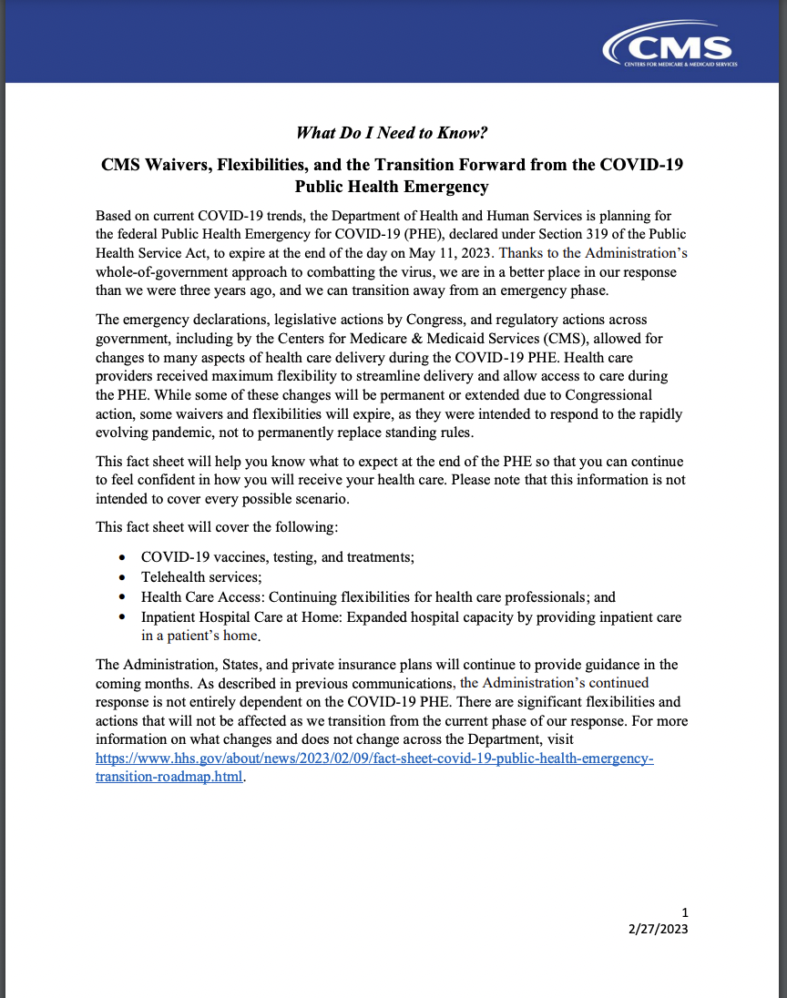
What Do I Need to Know by May 11, 2023?
•https://www.cms.gov/files/document/what-do-i-need-know-cms-waivers-flexibilities-and-transition-forward-covid-19-public-health.pdf
•https://www.cms.gov/about-cms/agency-information/emergency/epro/current-emergencies/current-emergencies-page
•https://www.cms.gov/coronavirus-waivers

Slide 49
Important PHE dates: May 11, 2023 December 31, 2023 December 31, 2024

Slide 50
Telehealth Before, During and After COVID-19

Slide 51
Timeline to Telehealth/Telemedicine
1600 - SMOKE SIGNALS
1850 - TELEGRAPH CAPABILITIES
1876 - TELEPHONIC COMMUNICATIONS
1900 – RADIO
1928 – TELEGRAPH, RADIO, AIRPLANES
1950 – CLOSED TELEVISION LINK
WARTIME USE OF ALL CAPABILITIES
1960 – INTERACTIVE TWO-WAY VIDEO LINK
1970’s – GOVERNMENT FUNDED FOR TELEMEDICINE RESEARCH
1980’s – INTERNET TRANSFORMS COMMUNICATIONS
1990’s – 2000’s – SLOW TO ADOPT

Slide 52
Telehealth Before COVID-19 Why Not Embraced and its Slow Adoption
Lack of industry urging
Lack of insurer support
Regulatory limitations
Lack of infrastructure
Additional licensure in additional states – conflicts
Technological challenges for older/less engaged patient population
Interferes with social norms to health care delivery

Slide 53
So in the end…
Telehealth was under-studied by industry and government
Telehealth was under-funded by industry and government
Low to no reimbursement
Telehealth was FROZEN out of innovation

Slide 54
ENTERS the PANDEMIC

Slide 55
Transformation of Telehealth During COVID-19
First (3) months, Administration added 144 telehealth services
Prior to COVID-19, reimbursement rates for telehealth services were typically 20% to 50% lower than for in-person visits. Currently, telehealth reimbursement is comparable to in-person
First (6) months of COVID-19, almost 40%, or about 24.5 million out of 63 million Medicare beneficiaries received a Medicare telehealth service
Most doctors continued for in-person visits, but telehealth visits have stabilized at 40%+ of all visits and that they expect this to be the “new normal”

Slide 56
Legislation to EXPAND Telehealth in 2020-2023
Telehealth Expansion Health
Knowing the Efficiency and Efficacy of Permanent (KEEP) Telehealth Options Act
Rural Telehealth Expansion Act
Permanent Telehealth “At Home” Act
Expanding Access Mental Health Services Act
Preventing Medicare Telehealth Fraud Act
Medicare Fraud Detection and Deterrence Act

Slide 57
“FRAUD and ABUSE is the KILLJOY at the telehealth party”
- Anonymous

Slide 58
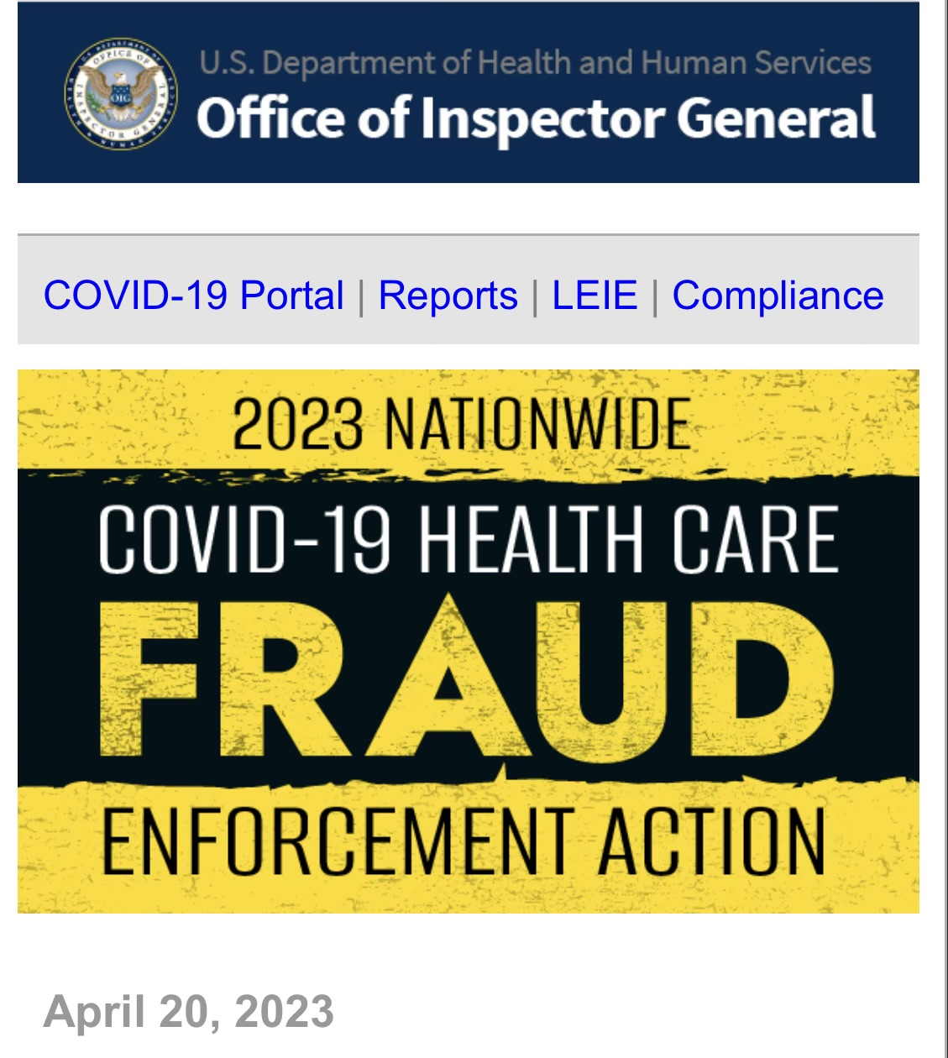
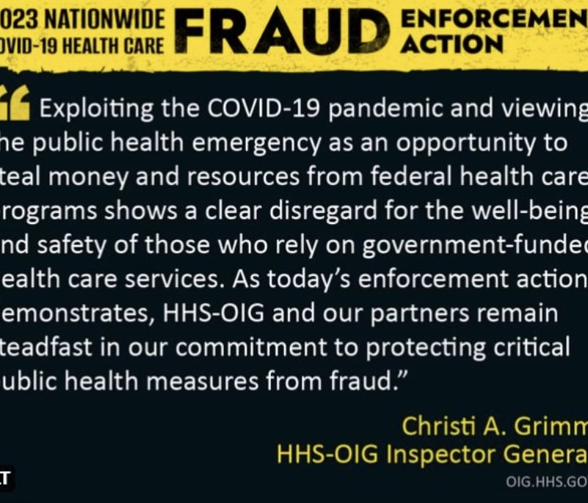
OIG ON STERIODS

Slide 59
OIG’s Goals
Fight
Fight fraud, waste, and abuse
Promote
Promote quality, safety, and value in HHS programs
Protect
Protect HHS beneficiaries
Advance
Advance excellence and innovation

Slide 60
Audits in Telehealth: On-going
Medicare Telehealth Services During the COVID-19 Emergency
Medicaid Telehealth Expansion During COVID-19 Emergency
Home Health Services Provided as Telehealth During the COVID-19 Emergency
Long-term Care Services Provided as Telehealth During COVID-19 Emergency
Hospice Services Provided In-setting During COVID-19 Emergency
Physician Practices with Telehealth During COVID-19 Emergency

Slide 61
Telehealth Can Equal Telefraud and Abuse
Lack of Understanding of Flexibilities
Upcoding Time and Complexity
Claims for Uncovered Services
Misrepresenting the Virtual Service Provided
Claims Did not Have Adequate Documentation
Cybersecurity Risk Exposure
Kickbacks from Telehealth Companies to Physicians for increased prescribing of medically unnecessary services and products
This Photo by Unknown Author is licensed under CC BY-NC-ND

Slide 62
The Enforcers
Medicare Administrative Contracts (MACs)
Uniformed Program Integrity Contractors (UPICs)
Medicaid Integrity Contractors (MICs)
Recovery Auditor Contractor (RACs)
Certified Error Rate Testing (CERTS)
State Probe Review (STPR)
Office of Inspector General (OIG)
Department of Justice (DOJ)
Targeted Probe and Education
(TPE)

Slide 63
Fraud and Abuse Laws
Anti-Kickback Statute (42 U.S.C. Section 1320a-7b(b)
Affordable Care Act – (42 U.S.C. 18001)
Exclusion Statute (42 U.S.C. 1320a-7)
Civil Monetary Penalties (42 U.S.C. Section 1320a-7a)
Physician Self- Referral Statute (42 U.S. Code § 1395)
False Claims Act (31 U.S.C. Section 3729-3733)
HIPAA and HITECH (42 U.S.C. 17935)

Slide 64
The Nuances of F-A-W-E
Fraud
Intentional
Deception
Abuse
Dereliction of understanding
Bending of rules
Waste
Inefficiencies;
Unnecessary costs
Errors
Mistakes
Human error
Overutilization

Slide 65
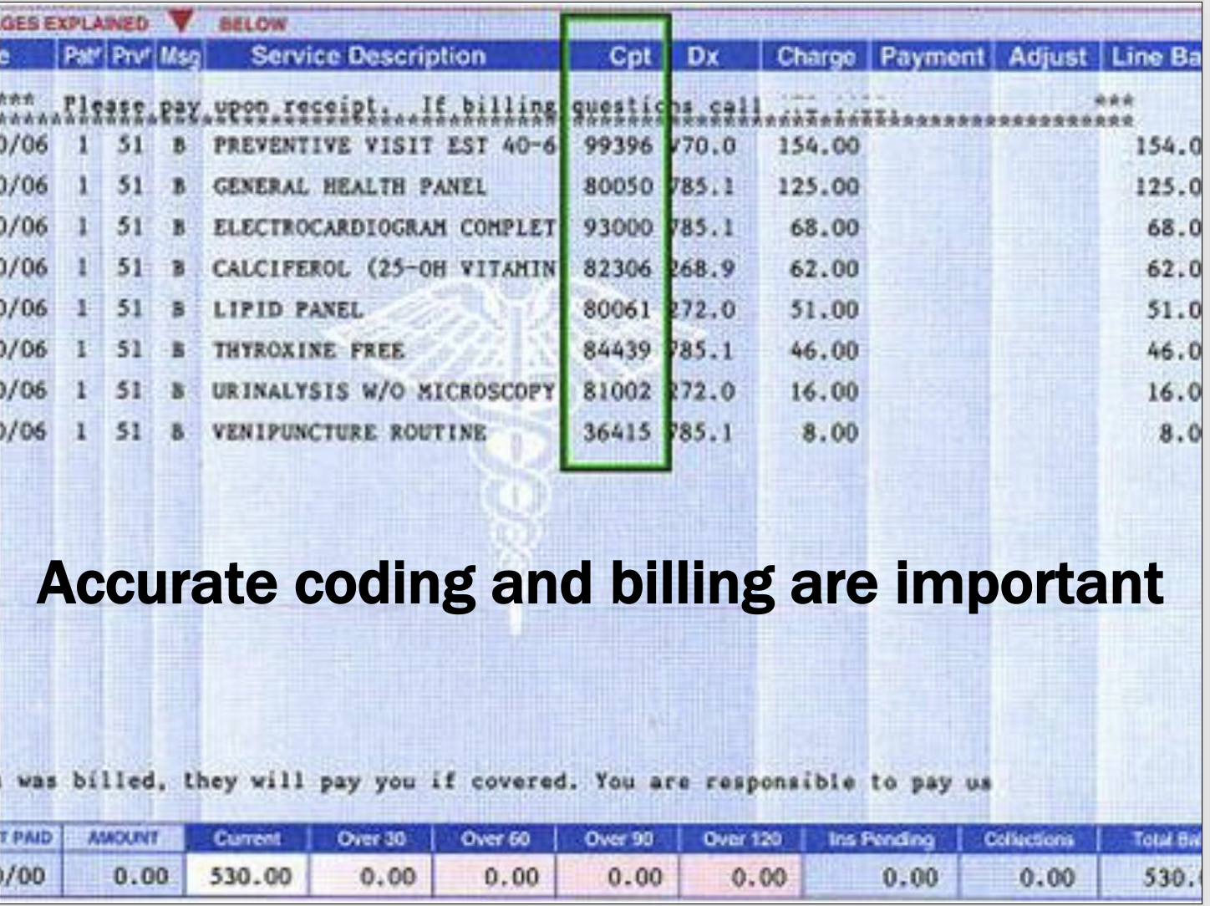

Slide 66
Billing and Coding Crisis
Misrepresentation of the type or level of service provided
Misrepresentation of the individual rendering service
Billing for items and services that are not medically necessary
Billing wrong codes allowing for “up-coding”
Billing separately for services already included in a global fee
Billing for items and services that have not been rendered
Billing ERRORs – incomplete information, wrong information
Billing for services that have not been properly documented

Slide 67
“If you didn’t document it, it’s the same as if you didn’t do it.”
“

Slide 68
“The OOPS Scenario”
If you ”realize” you have been improperly filing claims:
Immediately cease filing the problematic bills
All compliance staff and C-Suite immediately review problematic billing
Seek knowledgeable legal counsel
Forensically do “due diligence” to determine what money you collected in error
Formalize a detailed spreadsheet erroneous, overpayments
Consider using OIG’s or CMS’ self-disclosure protocols – self-reporting

Slide 69
“Dear Leigh …”
Is the government going to “claw back” unused COVID-19 funds?
Are there continued COVID-19 audits post-PHE?
I am told that Surprise Billing Act is not applicable to private practice physicians. Is that correct?
Are certain HIPAA requirements “relaxed” under the PHE? Will they continue under Post-PHE?
I don’t have thorough documentation for prove medical necessity – can I retroactively populate?
I ”think” I MAY have been overpaid for the past 2 years –what should I do? What is self-reporting?
How does my company ”self-audit”? Is there a methodology?
Do I have to appeal a denied claim or just leave it alone?
Can I turn an auditor, investigator away? What if there is ”no senior staff” available?
I have been placed under a pre-payment review? Why? How long will I be on one?
I may be steering my patients to products or services I have an interest in? What is considered steering
How do you know if an employee is becoming a ”whistleblower?” Can I STOP THEM?

Slide 70
All Things Lead to Compliance

Slide 71
Core Compliance Must Have’s
Constant monitoring
Implementation of regulatory changes
Complexity of regulations
Comprehension regulations/guidance
Integrity of billing/clean claims
Enrollment 855 - Updates
Conducts risk assessment or Internal audits
Compliance training for employees
Enforcement trends
Self - Reporting
Minimize ANY retaliation

Slide 72
Compliance Program: ( 7) Core Compliance Elements Identified
Designate a compliance officer in charge of operating the program
Develop and distribution of written policies, procedures and standards of conduct
Implement regular education and training program for employees
Develop an internal (self) audit system to identify problem areas
Develop a process where employees can come forward without fear of retaliation to report deficiencies - internally
Develop a system to report deficiencies and problem areas
Develop a means to quickly remedy problems in a systematic, transparent way and put in a corrective plan of action

Slide 73
Cheat Sheet to Compliance
Identify the differences between fraud, abuse, waste and errors
Identify trends, risk areas, problem spots, reoccurring in your industry
Identify governing legislation, regulations, and guidance documents
Identify the ENFORCERS auditing healthcare industry
Identify WHY and HOW to implement a compliance plan
Identify Implementing self-auditing protocols
Identify how to report if you violated the laws and regulations
Non-compliant

Slide 74
Please free to contact me at: Sldavitian@Dumbartonassociates.com

